Slide 1


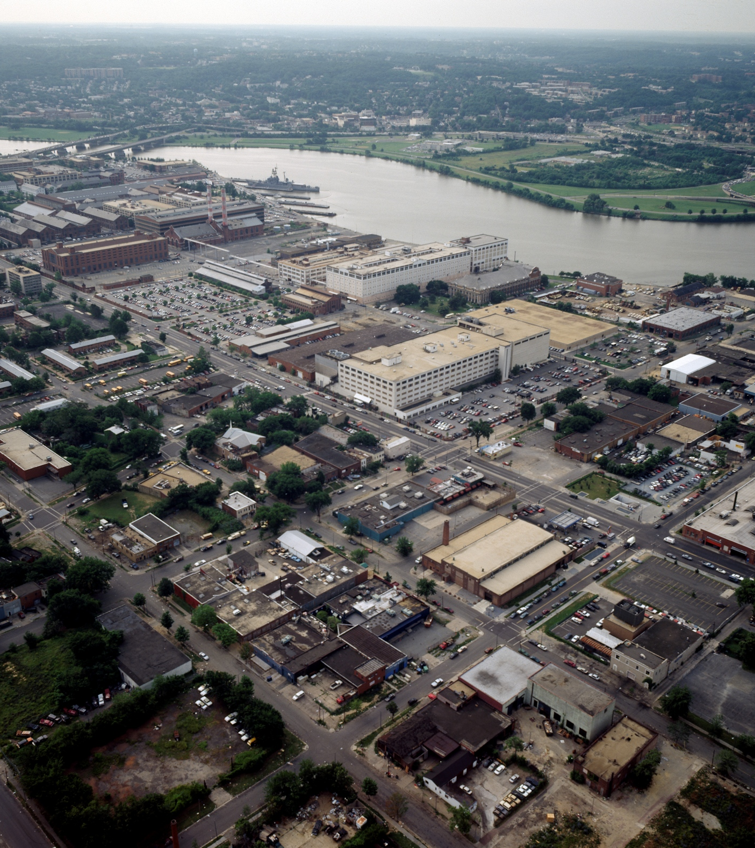
Thesis Proposal
Elizabeth Burch
The Library of Congress, Carol M. Highsmith Archive.

Slide 2
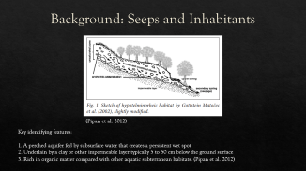
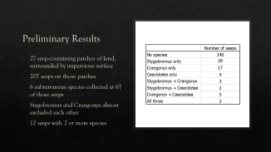
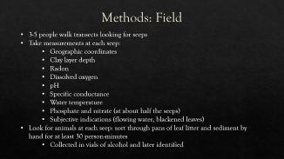
Spatial Habitat Parameters and Effects of Habitat Fragmentation on Hypotelminorheic Fauna in Seepage Springs in Southeast Washington, D.C.
Notes:
Working title
Three sections

Slide 3
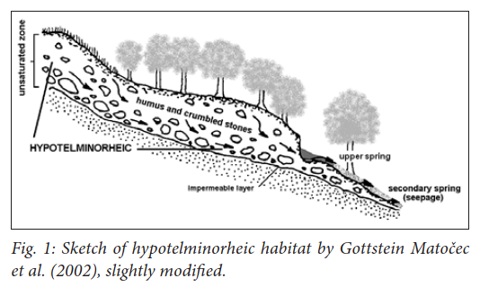
Background: Seeps and Inhabitants
(Pipan et al. 2012)
Key identifying features:
1. A perched aquifer fed by subsurface water that creates a persistent wet spot
2. Underlain by a clay or other impermeable layer typically 5 to 50 cm below the ground surface
3. Rich in organic matter compared with other aquatic subterranean habitats. (Pipan et al. 2012)
Notes:
Drawing of seepage spring – type of shallow
subterranean habitat
Point - habitat, exit where we sample
1. like a spring but less flow
2. groundwater fed but separated from water table
by clay layer
3. rich in organic matter

Slide 4
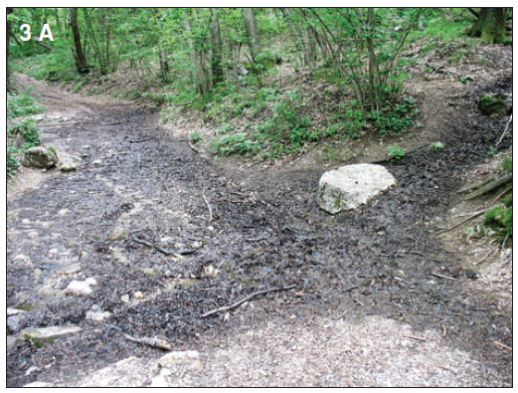
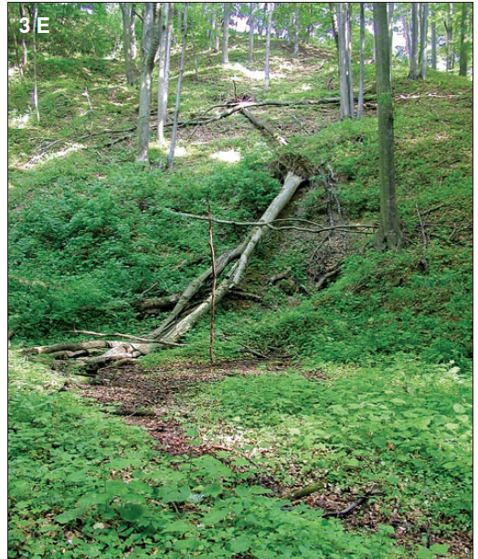
Background: Seeps and Inhabitants
Images from (Pipan et al. 2012)
Notes:
What a seepage spring looks like.
Wet spot in the woods; blackened leaves
Appears dry during summer, fall
Water temp moderated

Slide 5
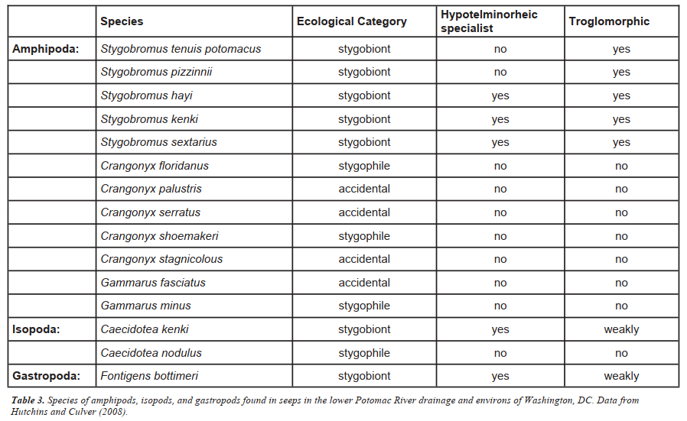
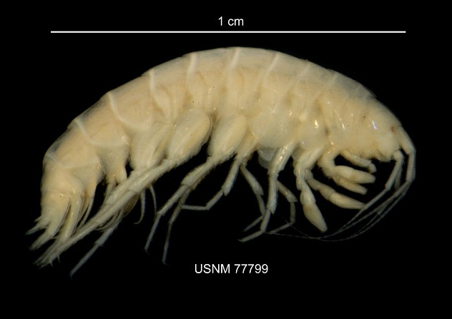
Background: Seeps and Inhabitants
Crangonyx shoemakeri, Department of Invertebrate Zoology Collections, Smithsonian National Museum of Natural History
(Culver & Pipan, 2008)
Notes:
List of species found in this area…
Some are specialist to this habitat, others - Crangonyx
shoemakeri is found not only in SSHs but also in
wetlands and some surface streams
Stygobromus is thought to be part of the deeper
groundwater environment and appears in the
seepage spring only seasonally, when water
temperatures are low, or flow is high

Slide 6
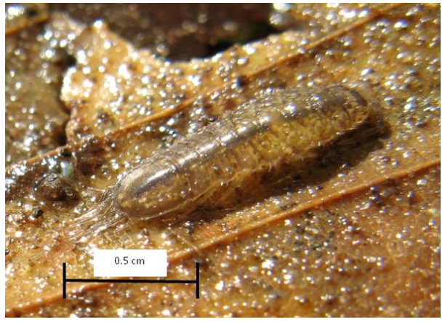
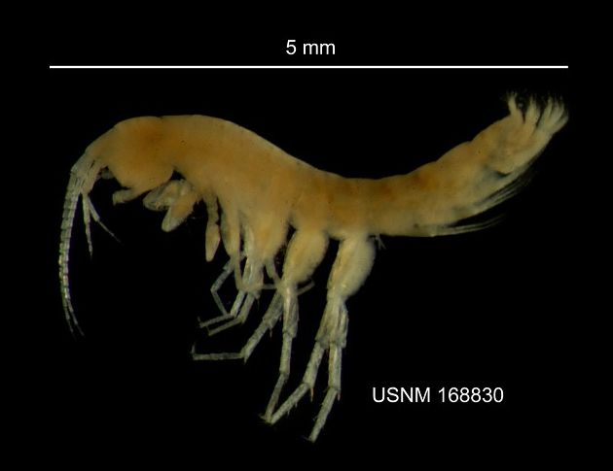
Background: Seeps and Inhabitants
Photograph of Caecidotea kenki collected from a seepage spring in Scott’s Run Regional Park (Virginia). Photograph by William K. Jones (Culver and Keany 2019)
Stygobromus kenki, Department of Invertebrate Zoology Collections, Smithsonian National Museum of Natural History
Notes:
-Inhabitants have the morphology of subterranean
animals - reduced or absent eyes and pigment, and
elongated appendages
-C. kenki is more of generalist, can be found yearround
in seeps & springs.
-Believed to come up to consume the rotting leaf
litter/organic carbon and nutrients, then burrow into
clay in summer when habitat is dry
-Can only be found when habitat is wet; very small
and difficult to sample so no abundance and species
richness

Slide 7
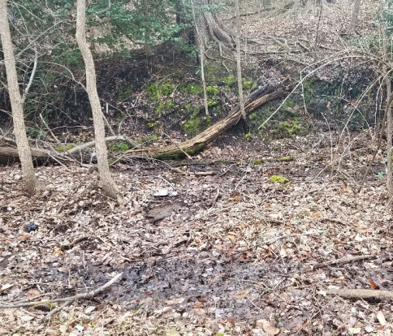
Seepage spring, Shepherd Parkway, NACE (Culver and Keany 2019)
Notes:
Each seep is discrete; dispersal is limited: could
disperse between seeps through the leaf litter or
surface water after rainfall, or through shallow
groundwater
THREATS: Pollution, flooding, soil compaction (like
from increased recreation use), new impervious
surfaces (like roads, trails) create habitat loss or
fragmentation. Loss of tree cover could increase
water temperature at the surface, dry the habitat
out, and decrease the amount of organic matter from
leaf litter.
Because they need leaf litter and trees/lower temps,
could be edge avoidant? And then more sensitive to
fragmentation.

Slide 8
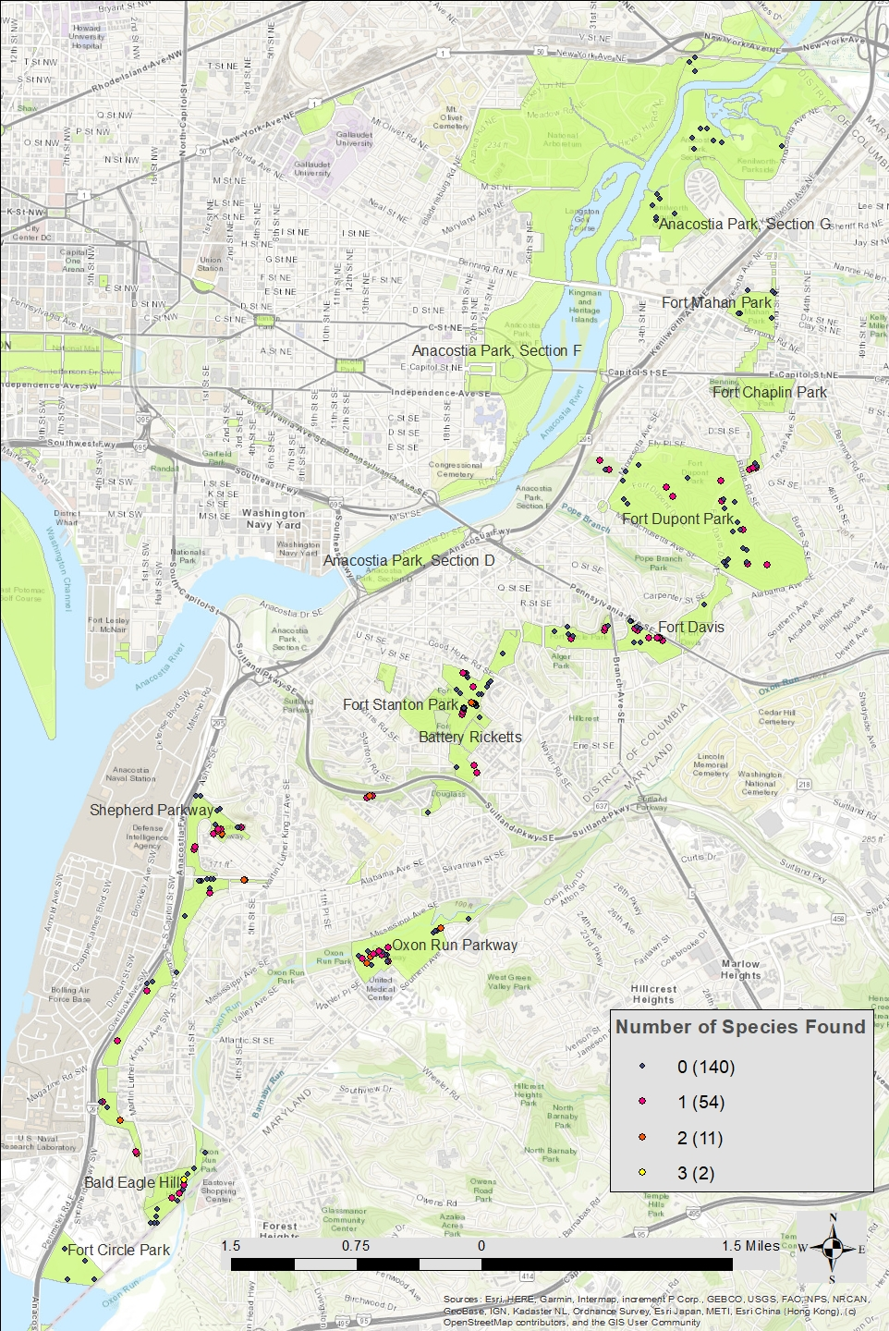
Study Area
NACE parklands in Southeast Washington, D.C.
NACE: National Capital Parks-East
National Parks Service sub-system of 13 parks and parkways located along the Anacostia River in D.C. and Maryland
Parks are small and fragmented by roads
Notes:
Read - NACE parklands located within Washington, D.C.,
between the Anacostia River and the border with
Maryland
Parks big but split up by roads

Slide 9
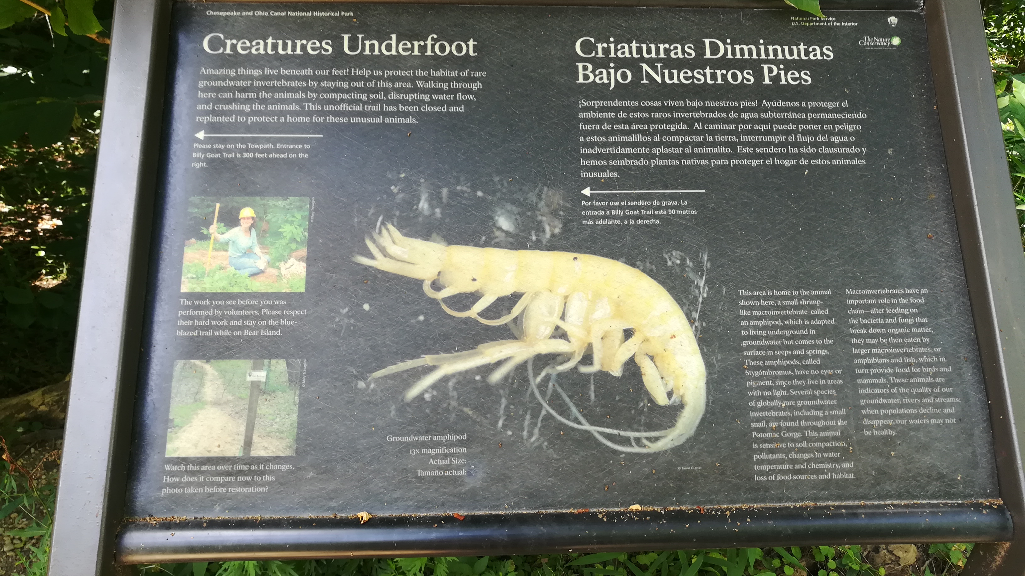
Notes:
NPS sign (on C&O towpath) shows Stygobromus,
points out that macroinvertebrates are a sign of
forest and ground/surface water health and can be
harmed by soil compaction and habitat loss
Just D.C. diamond:
7 amphipods, 1 isopod species, Living in 55 seeps
That’s just DC - regionally, Culver - 13 amphipods, 5
isopods, 23 total shallow
Almost no other area of the world has so many
subterranean amphipod species
ALL in protected parklands – so need to protect those
(outside, paving over & rainwater diversion
eliminated)
Parks decision making is one of the main justifications
for this research, along with characterizing the
habitat spatially.

Slide 10
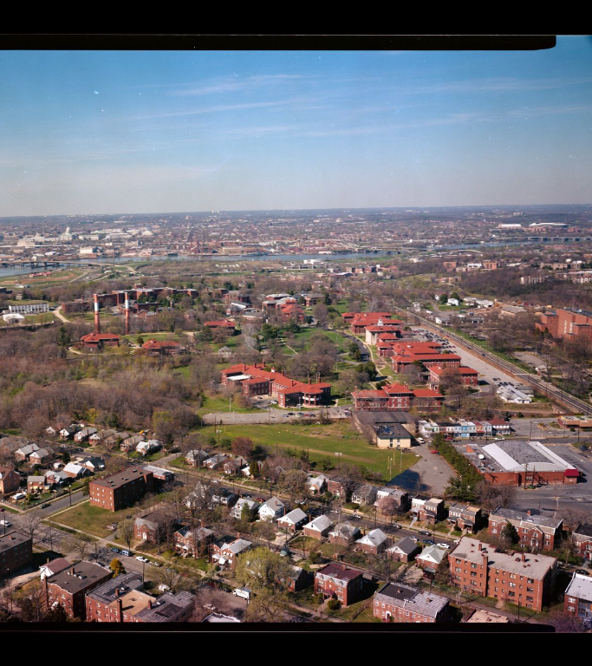

Research Questions
Is there an “edge” and a “core” for this habitat? Can an edge buffer distance be defined? Is the edge defined by roads, or also by yards or other pervious surfaces?
What is the spatial relationship between seeps and land patches? Is there a minimum number of seeps per land patch, per area, or minimum patch area required for a population to exist there?
Are there spatial covariates (surface features, patch dynamics, or isolation) that can predict whether seeps are inhabited or not? Or inhabited by two or more species? Or by any individual species?
Which currently inhabited land patches are nearing those minimums, and so at risk of becoming uninhabitable if further habitat destruction occurs there?
The Library of Congress, Carol M. Highsmith Archive.

Slide 11

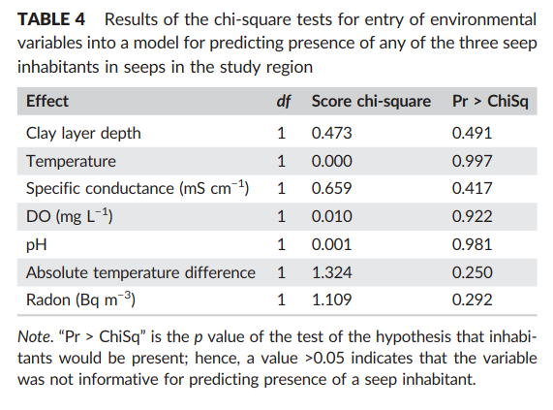
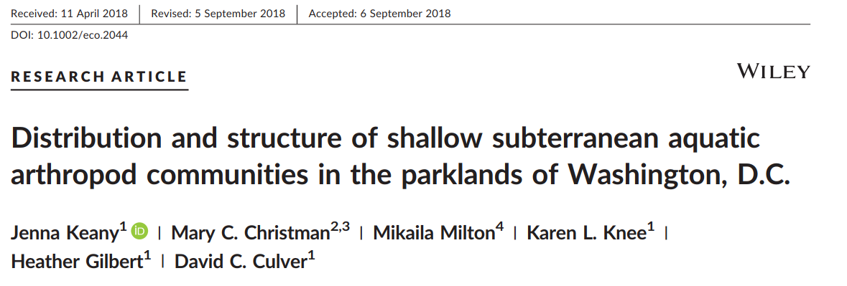
Context: Previous work in study area
(Keany et al. 2019)
Notes:
Keany’s work in same dataset – we take these
measurements at each seep; no physiochemical
parameters have been found to be significant in
predicting inhabited versus uninhabited seeps
Little is known about what type of habitat is required
or what they are sensitive to

Slide 12
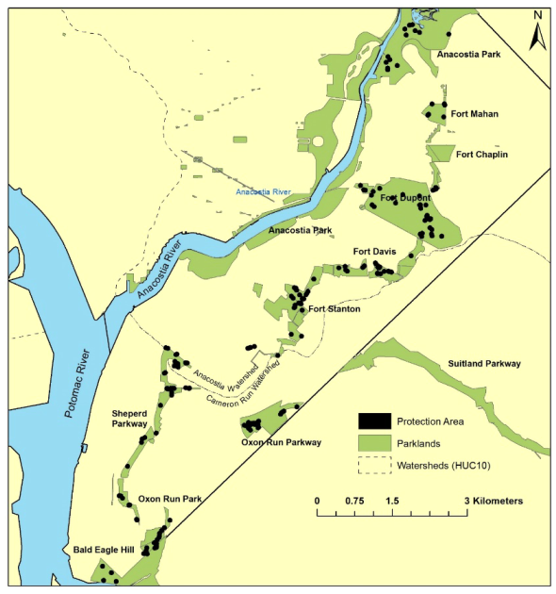
Protection map of National Capital Parks-East with 50m buffers around all seepage springs (Culver and Keany 2019)
“All activities within these zones should be curtailed to protect these rare and unique organisms. Special attention should be given to those sites close to major roadways in hopes of diminishing excessive road salt and run‐off from entering the seeps.” (Keany et al. 2019)
The Library of Congress, Carol M. Highsmith Archive.
Notes:
Keany/Culver map (sampling working up BW, 495 but
not complete)
protection buffer - ALL sites
Metapopulation theory – all sites should be
protected
Hypotelminorheic fauna are believed to form
metapopulations, because the local populations are
small and depend on migration between spatially
separated suitable sites. Local subpopulations blink
on and off, but extinction of the entire
metapopulation occurs if the available habitat is
reduced below a critical threshold level – So there
could be a minimum number of seeps needed on a
patch of land for animals to persist there.

Slide 13
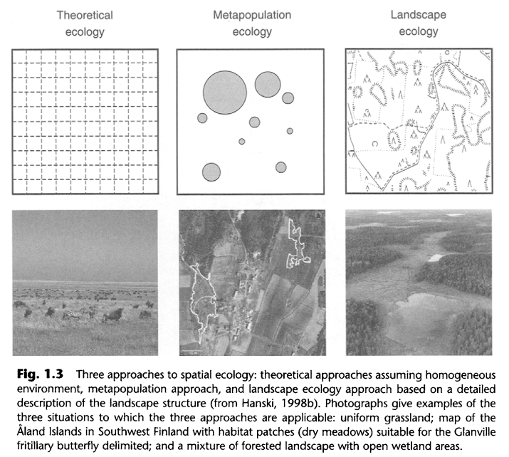
Context: Metapopulations and Fragmentation
(Hanski and Gaggiotti 2004)
Notes:
From text “Metapopulation Biology”
Three approaches to spatial ecology – how spatial
positions matter to population dynamics and
interactions.
1- theoretical ecology assumes completely
homogenous landscape - simplifies the study of
population processes
3- landscape ecology – other end of the spectrum –
complex structure of real landscapes (where the core,
edge stuff comes from)
2- metapopulation theory – discrete local populations
migrating between suitable habitat sites, across
unsuitable landscape. They have a patchy spatial
distribution. Applies particularly when species have
limited dispersal or a long-lasting microhabitat compared to their lifespan (ie insects that inhabit the
same oak tree for generations; parasites where the
host indiv. Is a habitat patch).
Since 80’s, increased interest due to applications to
conservation biology, due to habitat loss and
fragmentation – many species forced to conform to
model.
(--much research in European butterflies – specific
host plant and habitat requirements; great distinction
between the suitable habitat and the landscape
matrix )
Assumes identical and equally connected habitat
fragments; nothing in CMT about how spatial arrang.
affects the population.
“spatially realistic metapopulation theory” (Hanski
2001) - --combining two separate research traditions.
I’d like to be Hanski area, measure the effects of
patch isolation and connectivity on patch occupancy
and add in even more landscape ecology elements –
core area, habitat quality.

Slide 14
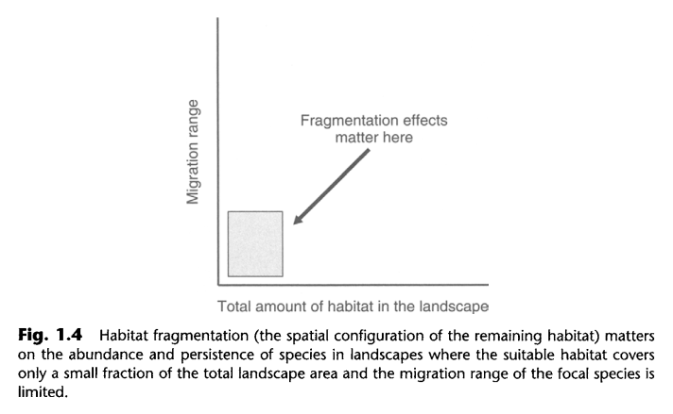
Context: Metapopulations and Fragmentation
(Hanski and Gaggiotti 2004)
Notes:
Where spatial configuration matters most: highly
fragmented landscapes, in which only a small fraction
of the total area is covered by the suitable habitat;
and relatively poorly dispersing species (at the scale
of interest)
Both – probably a metapopulation, but living in a
fragmented landscape

Slide 15
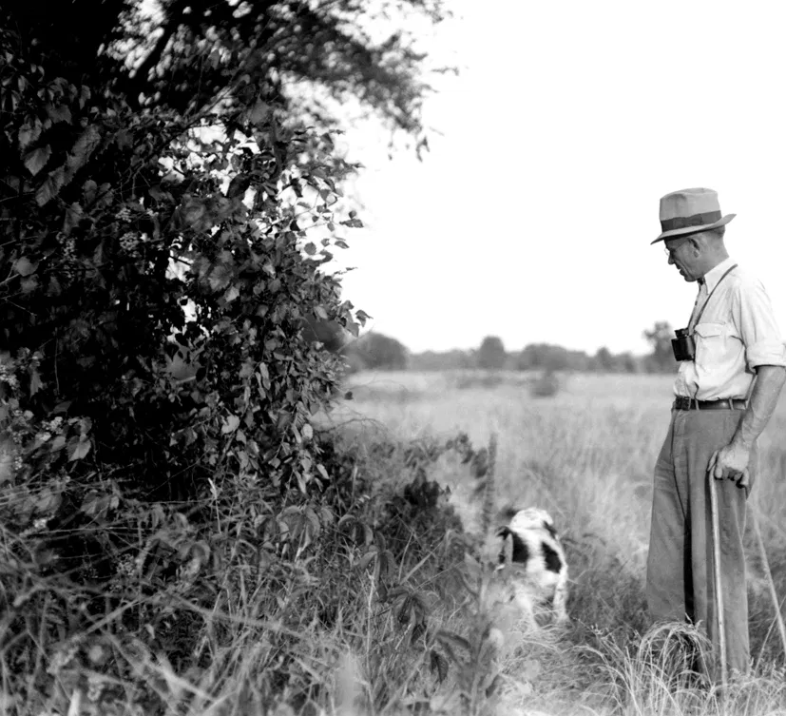
Patch dynamics
Edge effects
Edge / buffer distance
Core area
Compactness
Isolation/Connectivity
distance to nearest habitat patch
number of patches within a distance
Surface Features
Soil characteristics
Elevation
Topographic Wetness Index
Aldo Leoplod (Aldo Leopold Foundation)
https://edgeeffects.net/why-edge-effects/
Notes:
Types of things I’m looking at: list
-Edge where habitat changes like in pic, and edge or
border area has different microclimate/
predation/etc; varies by species and ecosystem.
-Core area integrates size, shape, and edge effects of
the patch, since patches that are smaller or have
more complex shapes will have less core
-Compactness (more circular) minimizes area
subjected to edge effects, dispersal distance
-TWI is a measure of surface hydrological conditions -
has been used to characterize forest habitat quality,
vegetation patterns, and net primary production

Slide 16
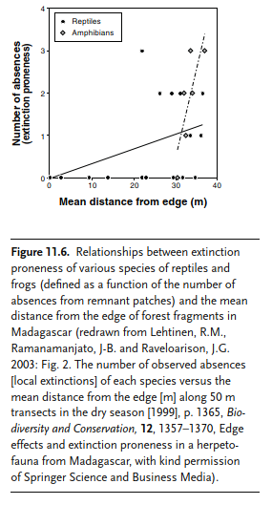
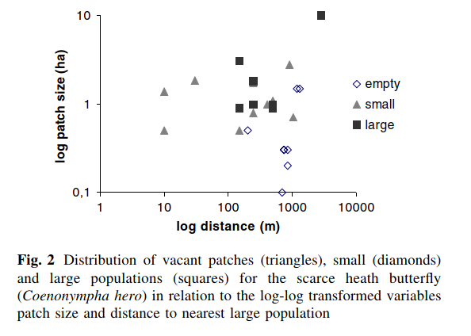
(Cassel-Lundhagen, Sjögren-Gulve, and Berglind 2007)
(Lindenmayer and Fischer 2006)
Notes:
Examples of studies that are similar to what I’d like to
be doing
1- One butterfly study (scarce heath butterfly): “We
found that a patch in this area needs to be at least
0.5 ha in size to have a high probability of being
occupied, and to be twice that size to support a large
population. Our observations suggest that the
surrounding and shading mature forest has a
significant negative impact on the viability of
butterfly populations in the smallest patches.”
2- reptiles and frogs in Madagascar (from Habitat
Fragmentation textbook) Relationships between the
number of absences from remnant patches and the
mean distance from the edge of forest fragments

Slide 17
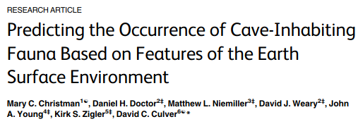
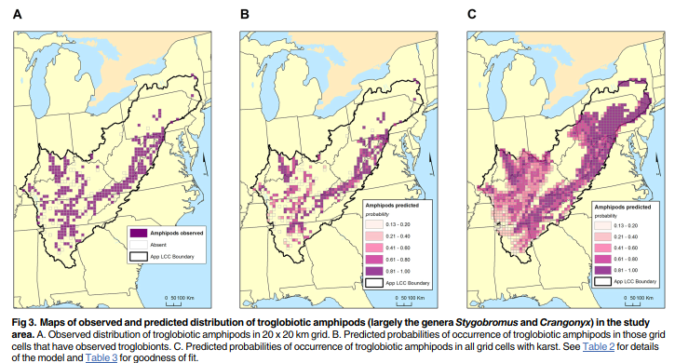
(Christman et al. 2016)
Notes:
Similar species but cave: In a logistic regression
model of cave fauna with 20 predictor variables,
Christman et al. found that amount of habitat (%
karst), latitude, temperature, precipitation, elevation,
and topographic position index were each predictive
of subterranean amphipod or isopod presence. Soil
characteristics were predictors for isopods but not
amphipods.

Slide 18
Methods: Field
3-5 people walk transects looking for seeps
Take measurements at each seep:
Geographic coordinates
Clay layer depth
Radon
Dissolved oxygen
pH
Specific conductance
Water temperature
Phosphate and nitrate (at about half the seeps)
Subjective indications (flowing water, blackened leaves)
Look for animals at each seep: sort through pans of leaf litter and sediment by hand for at least 30 person-minutes
Collected in vials of alcohol and later identified
Notes:
Have these but not planning to use

Slide 19
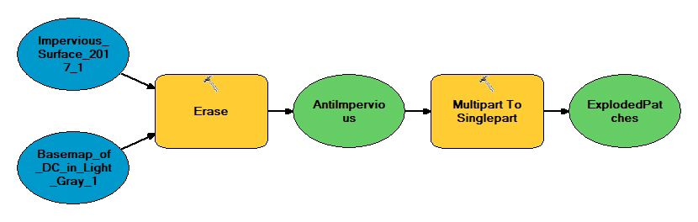
Methods: GIS
Notes:
Using ArcGIS 10.7,
• Make geographic coordinates into points
• Take a DC basemap, erase the “impervious
surfaces” layer out of it and turn what is left into
a “patches” polygon layer that represents the
pervious surfaces.
• Pull data from other public layers and add at each
seep point. Calculate other data using ArcMap.
• Patch statistics calculated for each patch

Slide 20
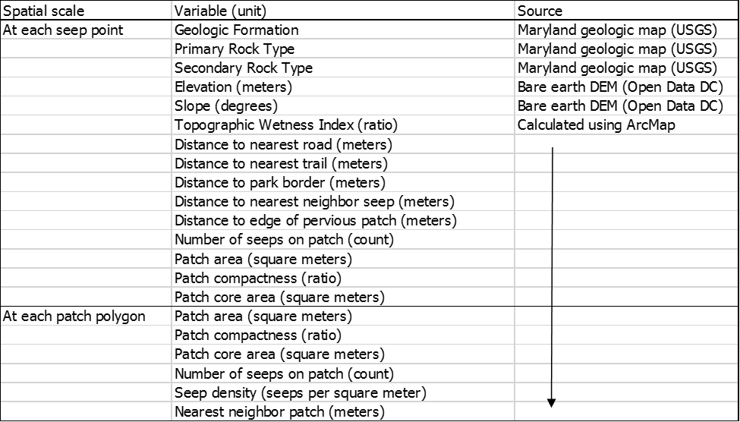
Methods: Stats
Notes:
Two spatial scales
Environmental/habitat quality variables, connectivity
(distance to source populations), and shape
(compactness, core area)
Elevation, soil type, and geologic formation are pulled
for each seep point from the DEM layer and the
Maryland geologic polygon layer. Slope, distance
from nearest road or trail, and distance from park
boundary are calculated and added at each seep
point. Topographic wetness index at each point is
calculated using slope, flow accumulation, and flow
direction, which are derived from the DEM. Distance
to nearest neighbor inhabited seep, number of
inhabited seeps on the patch, or another connectivity
measure will be calculated.
Using only the polygons that contain seep points, the
model also calculates patch statistics (compactness,
distance to nearest neighbor patch, number of seeps
in the patch). We will explore whether there is an
edge where animals are not commonly found by
modeling presence/absence of animals in seeps
against distance from the edge or road, using logistic
regression in SPSS. If a buffer distance can be
estimated, core area will be added to the model as
well. Patch statistics will be added to attribute tables
both at the patch level and at each seep.

Slide 21
Methods: Stats
Attempt to estimate edge distance by plotting presence/absence against distance from edge – logistic regression
If edge distance can be estimated, add core area calculation
At seep level: which new seep variables are predictive of occupancy? – logistic regression
At patch level: explore minimum patch parameters for a population to exist on the patch – linear regression
Describe threats to inhabited patches and especially “hotspot” seeps with 2+ species
Notes:
Assumption: they can’t migrate across impervious, so
each land patch contains a metapopulation
(expect that the probability of a seep being occupied will
increase with patch size and quality and decrease with
isolation)

Slide 22
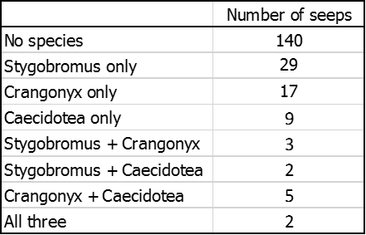
Preliminary Results
27 seep-containing patches of land, surrounded by impervious surface
207 seeps on those patches
6 subterranean species collected at 67 of those seeps
Stygobromus and Crangonyx almost excluded each other
12 seeps with 2 or more species

Slide 23
Preliminary Results
Inhabited seeps in this study area are on patches of land with a minimum of three seeps. Patches with one or two seeps are all uninhabited.
Land fragment areas range from 5,868m² to 2,308,837m² and nearest distances between fragments range from 1m to 590m

Slide 24
References
Cassel-Lundhagen, A., P. Sjögren-Gulve, and S.-Å. Berglind. 2007. "Effects of patch characteristics and isolation on relative abundance of the scarce heath butterfly Coenonympha hero (Nymphalidae)." Journal of Insect Conservation 12 (5): 477-482. https://doi.org/10.1007/s10841-007-9083-8.
Christman, M. C., D. H. Doctor, M. L. Niemiller, D. J. Weary, J. A. Young, K. S. Zigler, and D. C. Culver. 2016. "Predicting the Occurrence of Cave-Inhabiting Fauna Based on Features of the Earth Surface Environment." PLoS One 11 (8): e0160408. https://doi.org/10.1371/journal.pone.0160408.
Culver, D. C., and T. Pipan. 2008. "Superficial subterranean habitats–gateway to the subterranean realm." Cave and Karst Science 35 (1-2): 5-12, http://www.bcra.org.uk/pub/candks/index.html?j=103.
Culver, D. C., and J. M. Keany. 2019. A Survey of the Fauna of Seepage Springs In National Capital Parks—East (NACE): Final Report for the D.C. Section.
Hanski, I., and D. Simberloff. 1997. "The Metapopulation Approach, Its History, Conceptual Domain, and Application to Conservation." Metapopulation Biology, edited by Ilkka Hanski and Michael E. Gilpin, 5-26. San Diego: Academic Press. https://doi.org/10.1016/b978-012323445-2/50003-1.

Slide 25
References
Hanski, I. 2001. "Spatially realistic theory of metapopulation ecology." Naturwissenschaften 88 (9): 372-81. https://doi.org/10.1007/s001140100246.
Hanski, I., and O. Gaggiotti. 2004. "Metapopulation biology: past, present, and future." Ecology, genetics and evolution of metapopulations, 3-22 Elsevier. https://doi.org/10.1016/B978-012323448-3/50003-9.
Keany, J., M. C. Christman, M. Milton, K. L. Knee, H. Gilbert, and D. C. Culver. 2019. "Distribution and structure of shallow subterranean aquatic arthropod communities in the parklands of Washington, D.C." Ecohydrology 12 (1). https://doi.org/10.1002/eco.2044.
Levins, R. 1969. "Some Demographic and Genetic Consequences of Environmental Heterogeneity for Biological Control." Bulletin of the Entomological Society of America 15 (3): 237-240. https://doi.org/10.1093/besa/15.3.237.
Lindenmayer, D. B., and J. Fischer. 2006. Habitat Fragmentation and Landscape Change : An Ecological and Conservation Synthesis. Washington, United States: Island Press. http://ebookcentral.proquest.com/lib/aul/detail.action?docID=3317424.
Pipan, T., C. Fišer, T. Novak, and D. C. Culver. 2012. "Fifty Years of the Hypotelminorheic: What Have We Learned?" Acta Carsologica 41 (2-3): 275-285. https://doi.org/10.3986/ac.v41i2-3.564.

